Slide 1
Inheritance of Traits
Year 11 Human Biology
ATAR
PowerPoint #22

Slide 2
SCSA Syllabus Reference
probable frequencies of genotype and phenotype of offspring can be predicted using Punnett squares and by taking into consideration patterns of inheritance, including the effects of dominance, co-dominance, autosomal or sex-linked alleles, and multiple alleles: Huntington's disease, phenylketonuria (PKU), ABO blood groups, red–green colour blindness/haemophilia show different inheritance patterns
pedigree charts can be constructed for families with a particular genetic disorder and can be used to reveal patterns of inheritance and assist in determining the probability of inheriting the condition in future generations
DNA profiling identifies the unique genetic make-up of individuals and can be used in determining parentage

Slide 3
Lesson Intention
To explore the inheritance of traits

Slide 4
Success Criteria
recall the process of Mendelian Inheritance and Mendel’s experiments
distinguish between genotypes and phenotypes of organisms
use Punnett squares to predict the probability of genotypes and phenotypes of offspring
use pedigrees to investigate patterns of inheritance
describe dominant and recessive, autosomal inheritance of single-gene disorders
give examples of dominant and recessive, autosomal inheritance of single-gene disorders
explain how sex chromosomes determine gender at birth
discuss different sex-linked characteristics and their patterns e.g. red-green colour-blindness
describe other types of inheritance e.g. co-dominance and multiple alleles

Slide 5
Vocabulary
Trait: the characteristics due to the genetic constitution of an individual
Dominant trait: one of a pair of contrasting characteristics, which is controlled by an allele that is not masked by other alleles
Recessive trait: one of a pair of contrasting characteristics, which is controlled by an allele that is masked by dominant alleles

Slide 6
Vocabulary
Alleles: the alternative form of a gene that occur at a given point in a chromosome
Genotype: the genetic constitution of an individual
Phenotype: the appearance of an individual as determined by their genetic constitution

Slide 7
Vocabulary
Homozygous: possessing the same alleles for a given characteristic
Heterozygous: possessing different alleles for a given characteristic
Punnett Square: a grid used to predict the possibility of genotypes of an offspring

Slide 8
Vocabulary
Pedigree: a family tree
Single-gene disorders: a disorder caused by the inheritance of a single defective gene
Sex chromosomes: the pair of chromosomes that determine the sex of an individual
Autosomes: a non-sex chromosome

Slide 9
Vocabulary
X-linked characteristics: a characteristic determined by genes carries on the X chromosome
Co-dominance: when contrasting alleles both affect the appearance of an individual and neither is dominant over the other

Slide 10
Mendelian Inheritance
Gregor Mendel put forward two principles relating to inheritance:
The various hereditary characteristics were controlled by factors (now called genes) that occurred in pairs.
During the formation of the gametes, the pair of factors separate. Each gamete receives only one set of factors (genes), with the other set going to another gamete. Gametes unite at fertilisation, allowing different combinations of genes to come together.

Slide 11
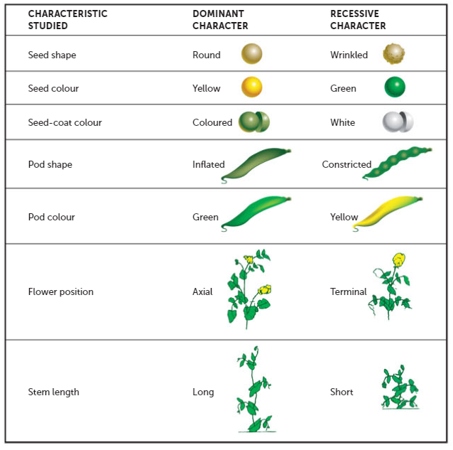
Mendel’s experiments

Slide 12
Dominant and recessive
A cross is the mating of two organisms. In a monohybrid cross, only one pair of contrasting characteristics is studied- for example, yellow and green pod colour in peas, or tongue rolling and non-rolling in humans.
We represent genes using letters. A capital letter represents a dominant gene, and a lower case letter represents a recessive gene.

Slide 13
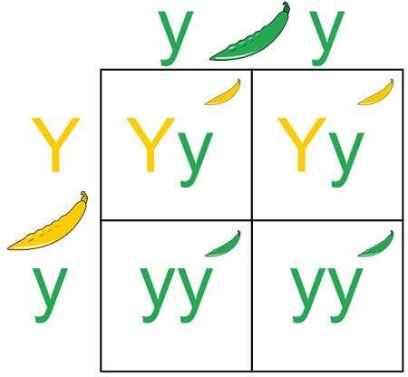
Example- Pea Plants
The yellow (Y) is the dominant gene.
The green (y) is the recessive gene.
The alternative forms of the gene for pea colour are called alleles.
The combinations show the possible outcomes after mating (Yy or yy).
yy is an example of homozygous alleles, Yy is an example of heterozygous alleles.

Slide 14
Genotypes and Phenotypes
The phenotype is the physical appearance of a trait as determined by the genotype, the combination of alleles.
Commit it to memory!
Genotype is the combination of letters, phenotype is what those letters code for.

Slide 15
Punnett Squares
Can be used to model a cross and calculate the probability of genotypes and phenotypes of offspring.
*Punnett Square worksheet

Slide 16
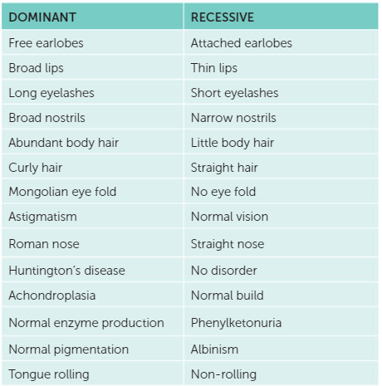
Some inherited traits in humans

Slide 17
Pedigrees
A pedigree, or family tree, is used to look at the phenotypes that have been produced in a family.

Slide 18
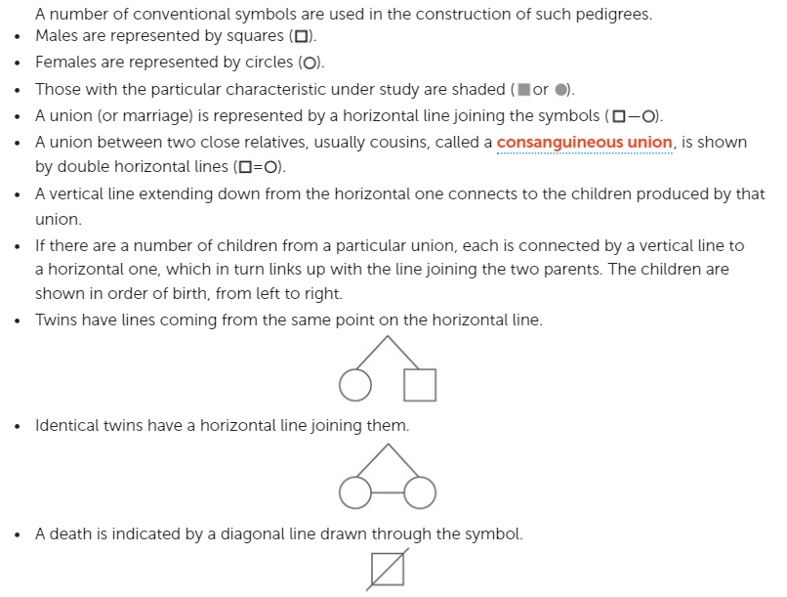
Rules of pedigrees

Slide 19
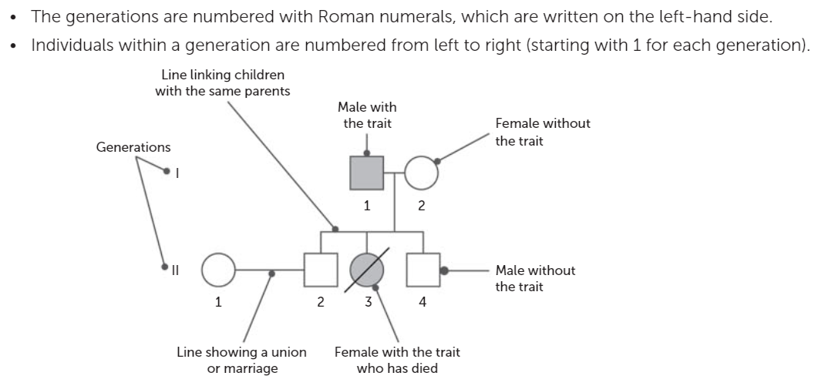

Slide 20
Example- Albinism
In a small percentage of people, humans fail to synthesise one of the enzymes involved in the production of melanin and pigmentation does not occur. These individuals have white skin, white hair and pink eyes.
The dominant allele controls normal enzyme production and the recessive allele causes abnormal enzyme production, resulting in albinism.

Slide 21
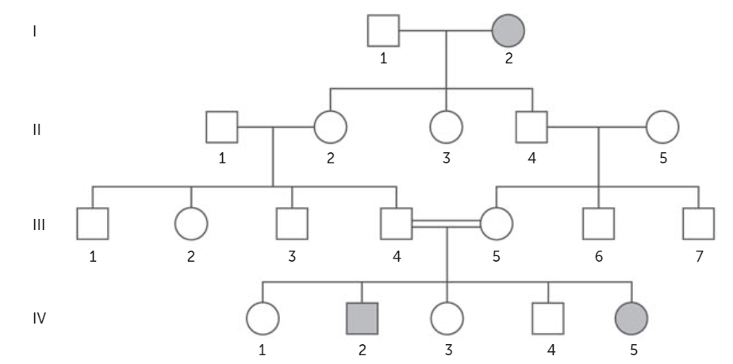

Slide 22
Without opening your textbook, see if you can identify the genotypes of the individuals in the family tree.

Slide 23
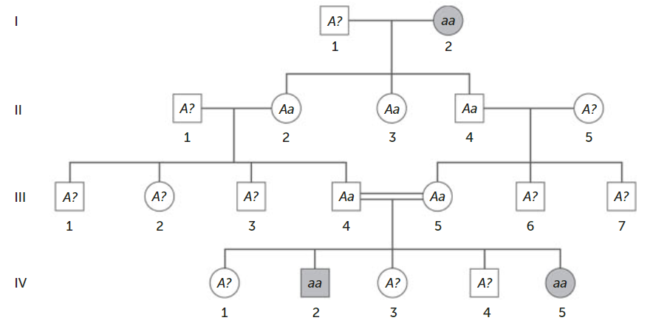
Answer

Slide 24
*Pedigrees worksheet

Slide 25
Autosomal Inheritance of Single-Gene Disorders
One of the most frequent reasons for constructing a family pedigree is to investigate the pattern of inheritance of a genetic disorder.
Single-gene disorders are caused by the inheritance of a single defective gene. The severity of the disorder is often variable and hard to predict.
Remember we have 46 chromosomes, 44 are autosomal and 2 are sex chromosomes.

Slide 26
Dominant, autosomal inheritance
Traits caused by dominant alleles are easily passed on, as only one allele is needed to activate/show the trait.
Dominant alleles that cause severe defects are rarely passed on, because people with them usually die before they can reproduce.
E.g. Huntington’s disease which is an inherited disorder that results in the death of brain cells (changes to mood, mental ability and movement)

Slide 27
Recessive, autosomal inheritance
A person who has a heterozygous genotype has a recessive allele that is masked. They are called carriers.
The chance of a severe recessive disorder not linked to a sex chromosome is low.
E.g. Phenylketonuria (PKU) and cystic fibrosis
https://www.youtube.com/watch?v=0sauoF4ppwA

Slide 28
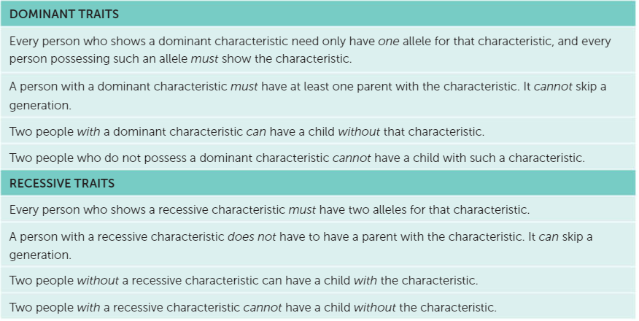
Using pedigrees for single-gene disorders

Slide 29
Sex determination
The chances of having a girl or boy are 50/50.
The father’s sperm determines the sex of the child.

Slide 30
Sex-linked characteristics
We know the Y chromosome is very small in comparison to the X chromosome. This means that the Y chromosome cannot have the same number of genes in it as the X chromosome.
Most of the genes in the X chromosome will lack mataching alleles in males.

Slide 31
Sex-linked characteristics
When characteristics on the X chromosomes are studied and patterns identified they are called sex-linked characteristics or x-linked characteristics.

Slide 32
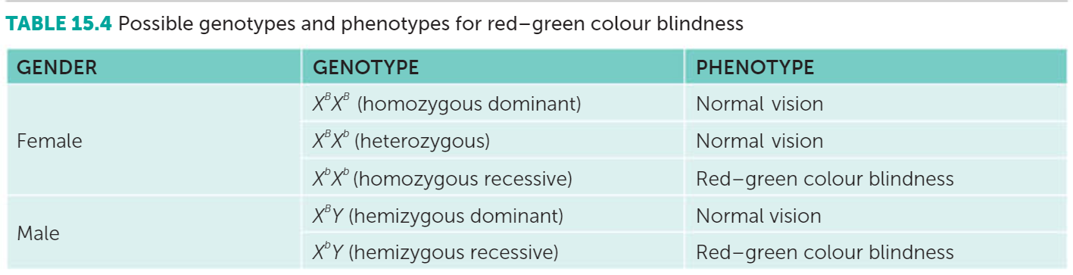
Red-Green Colour Blindness

Slide 33
Hemizygous
Describes an individual who has one only one member of a chromosome pair or chromosome segment rather than the usual two.
Often used to describe X-linked genes in males who have only one X chromosome.

Slide 34
Red-Green Colour Blindness
A recessive allele is able to be masked by the presence of a dominant allele in females. This is not possible in males; therefore, the frequency of colour blindness is higher in males than in females.
Females can be carriers for colour blindness if they have the recessive allele.

Slide 35
Haemophilia
Another sex-linked characteristic. Rare disease in which the blood clots slowly or not at all.
The defective allele is carried on the X chromosome. Males can therefore be normal or haemophiliac. Females can be normal, carriers or haemophiliacs.
It is a recessive disease

Slide 36
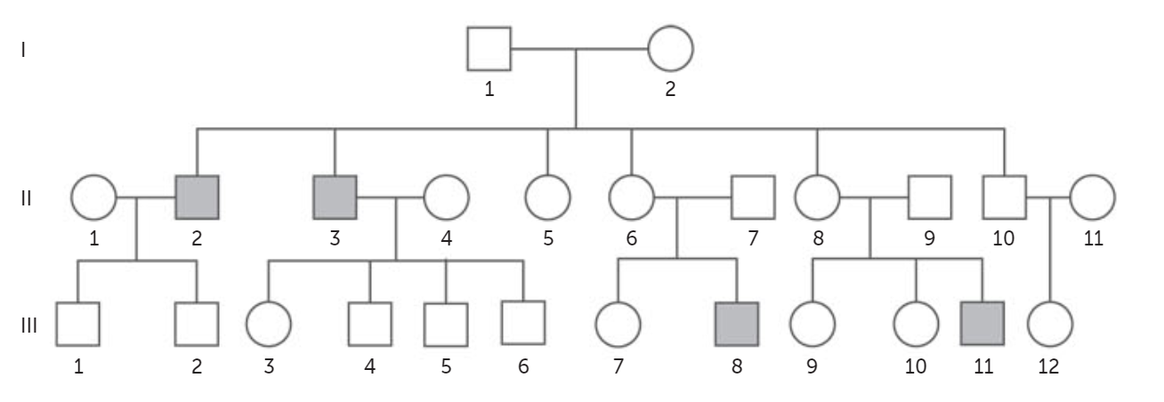
Patterns with sex-linked inheritance
This is a pedigree for a recessive sex-linked trait. Fill in the genotypes. No cheating.

Slide 37
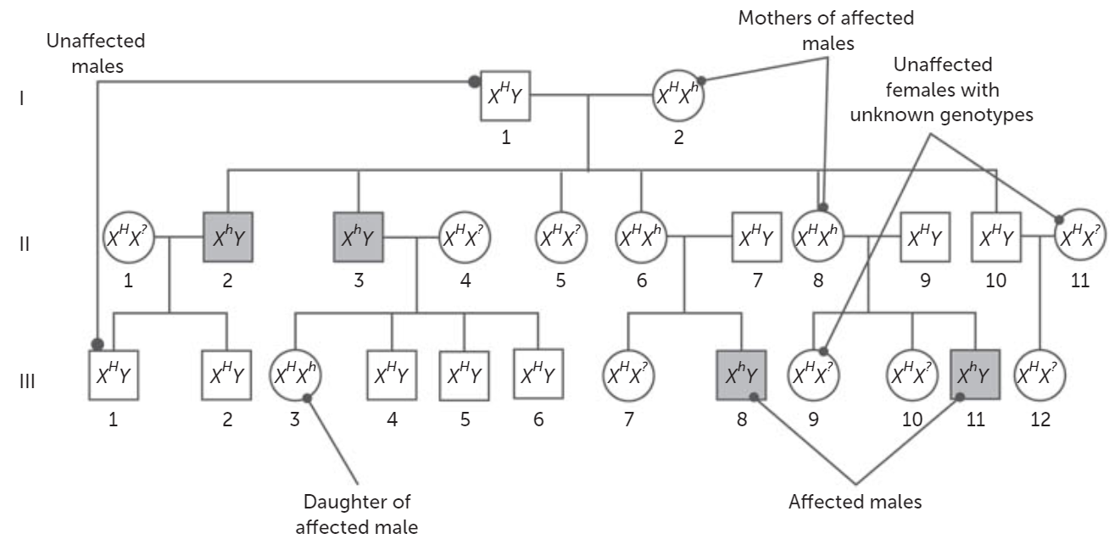

Slide 38
Co-dominance
Is a situation where two or more alleles are equally dominant. This means that if both alleles are present, they will be both observed.
E.g. The B^{M} and B^{N} alleles for the M and N antigens in human blood. Neither allele is dominant, and so three outcomes are possible:
Type M blood- B^{M}B^{M}
Type N blood- B^{N}B^{N}
Type MN blood- B^{M}B^{N}

Slide 39
Multiple alleles
Sometimes there are more than two alleles for a particular characteristic. They are called multiple alleles and their position on a chromosome is called multiple allelic. E.g. ABO blood groups.

Slide 40
Blood groups
Genotype | Phenotype | Blood group | Description
I^{A}I^{A} I^{A}i | Antigen A | A | Homozygous dominant Or Heterozygous
I^{A}I^{B} | Antigen A and Antigen B | AB | Co-dominant
I^{B}I^{B} I^{B}i | Antigen B | B | Homozygous dominant Or Heterozygous
ii | Neither Antigen A nor Antigen B | O | Homozygous Recessive

Slide 41
Recall Knowledge
How can someone be a carrier of a genetic disorder?
Prove that the chance of having a boy is 50%.
A child’s blood type is AB. List all the possible genotypes of the parents. Use Punnett squares to support your answer.

Slide 42
Apply Knowledge
Explain why males are referred to as ‘hemizygous’ when referring to sex-linked characteristics.
Explain why a parent with type O blood can have a child with type A blood, but not type AB

Slide 43
Homework
In humans, free earlobe are dominant over attached earlobes. A woman heterozygous for free earlobes marries a man with attached earlobes. Use a Punnett Square to determine their chance of producing offspring with attached earlobes.

Slide 44
Reading
Pages 385 - 405: Genetics can be used to understand the traits of individuals and families.

